Slide 1
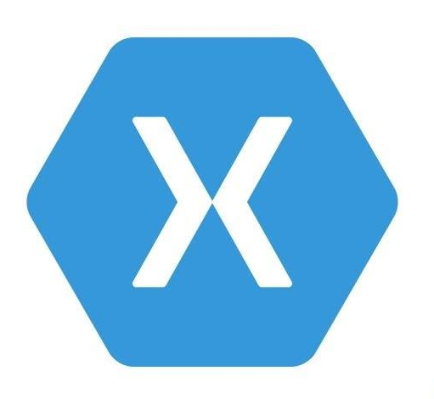


Cross-Platform App Development with Xamarin and Visual Studio App Center
Final Presentation: Peiren Yang

Slide 2
Project Target
Build an infrastructure for app development which supports:
Cross-platform app, one set of code generates at least 3 different applications for Android, iOS and Windows.
Source Control, which allows version control and teamwork
Automatic Build
Automatic Test
Release and Deployment management in relation to different app Stores

Slide 3
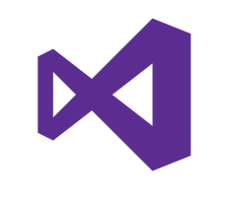
Solution Approach – Cross-Platform
Xamarin
Projects created with Xamarin framework can be compiled to Android, iOS and Windows UWP apps.
C# is the programming language
Supported in Visual Studio
Offers test framework “Xamarin.UITest”

Slide 4

Solution Approach – Source Control
Git under the hosting of GitHub
Git is one of the most popular source control and version management tool
Operations integrated in Visual Studio
GitHub as remote hosting, so that no local Git server is needed
GitHub offers non-public repository for privacy protection ($9 each)

Slide 5
Solution Approach – Continuous Integration
Automatic Build with Visual Studio App Center
Three different platform build separately
Build can be triggered by each push to the GitHub repository
Build process can be controlled and configured with scripts
post clone script
pre-build script
post-build script

Slide 6
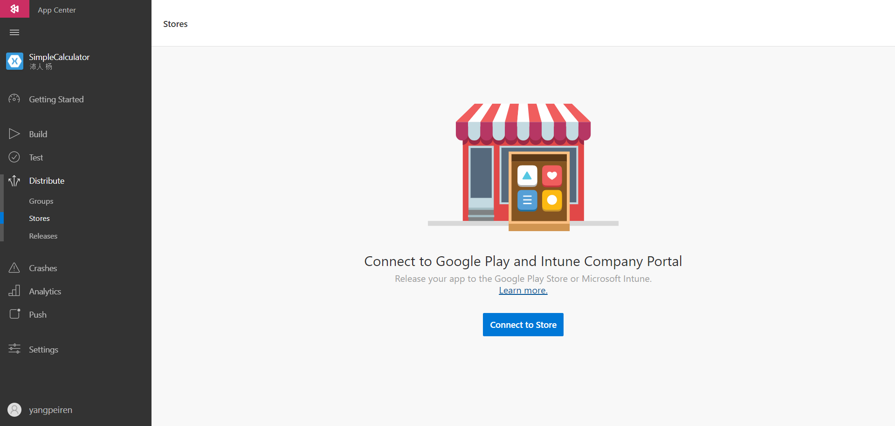
Solution Approach – Continuous Integration
Publish built apps with Visual Studio App Center
Stores can be connected to App Center, which makes the publish more efficient

Slide 7
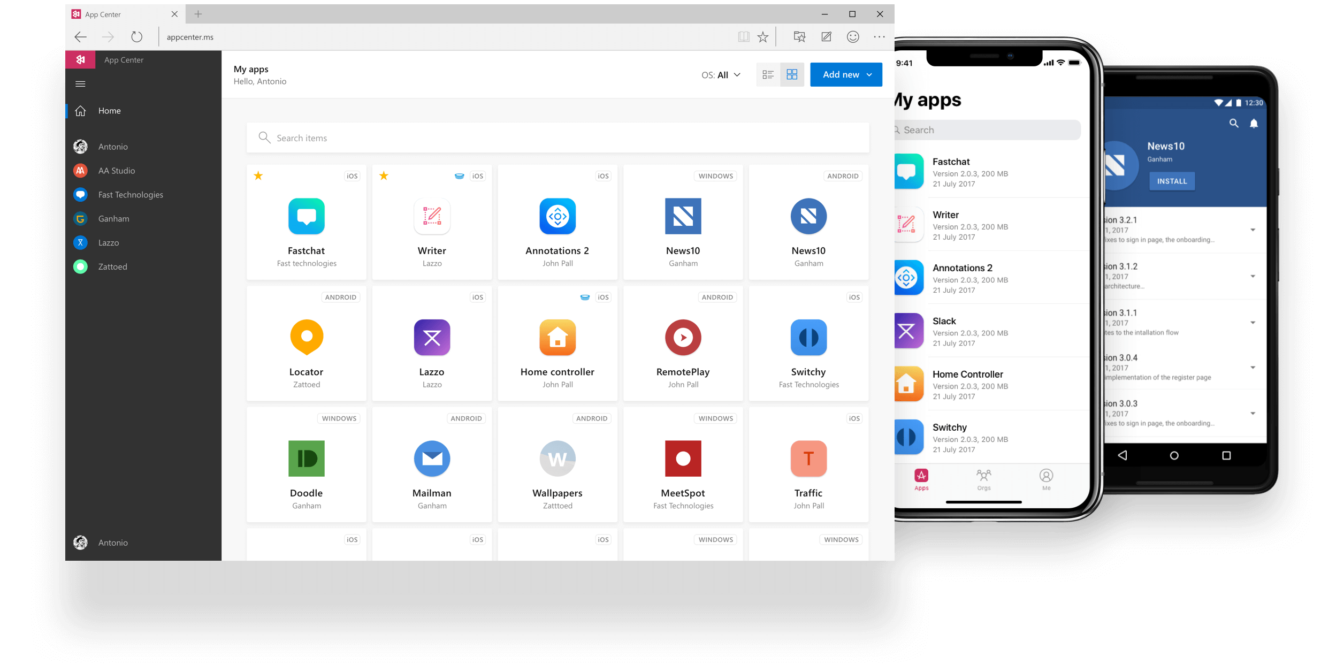
Solution Approach – Continuous Integration
Automatic Test with Visual Studio App Center
Device farm includes more than 2,000 devices with different OS versions

Slide 8
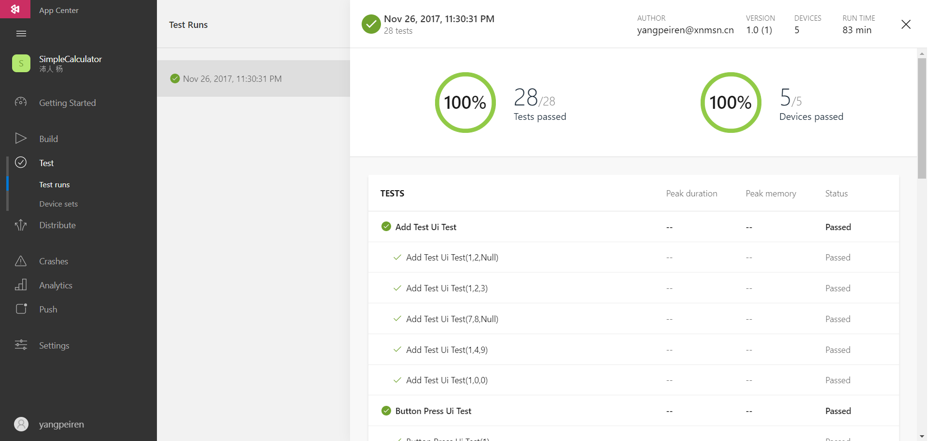
Solution Approach – Continuous Integration
Automatic Test with Visual Studio App Center
User-friendly statistical analysis

Slide 9
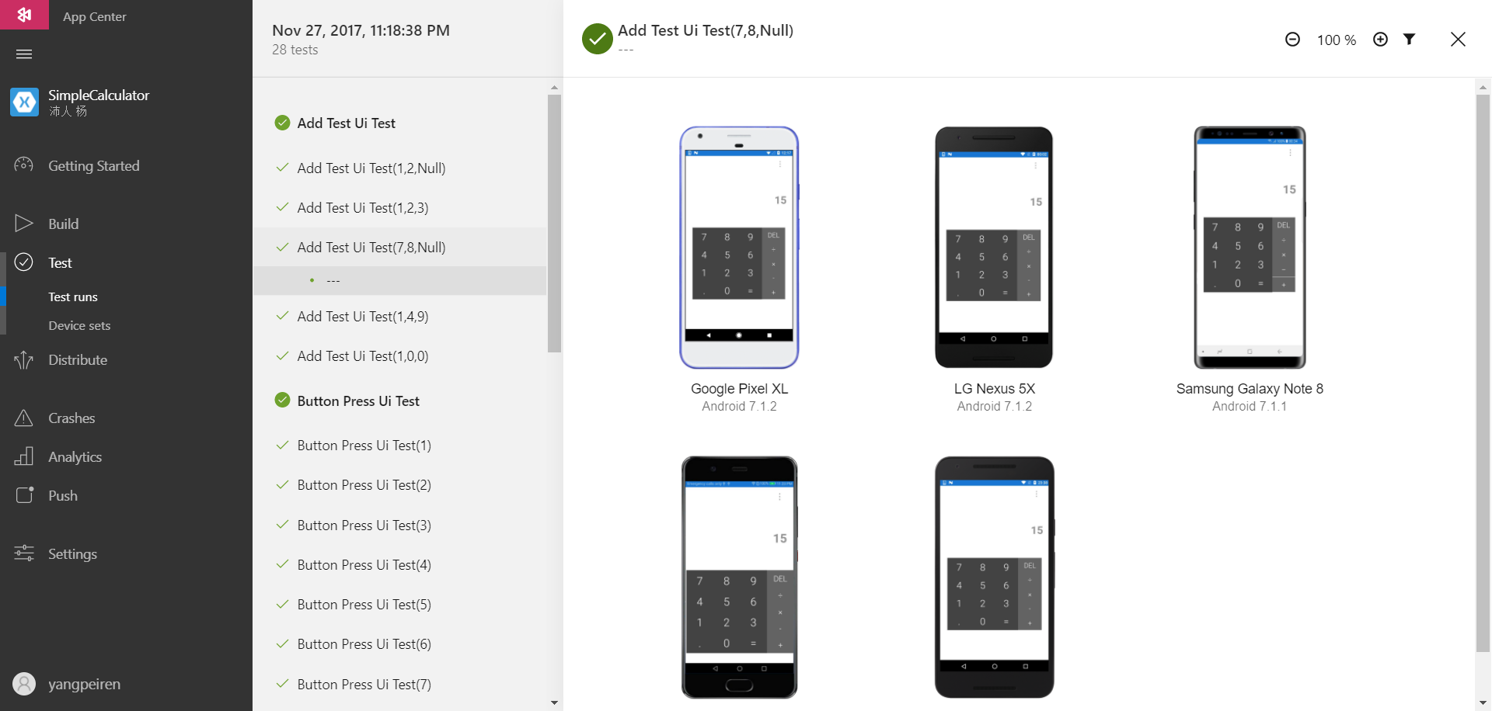
Solution Approach – Continuous Integration
Automatic Test with Visual Studio App Center
Automatic screen shots for each test device

Slide 10
Solution Approach – Continuous Integration
Automatic Test with Visual Studio App Center
Test devices can be defined as device set and referenced many times
Running resources like RAM consumption can be captured and added to statistical information
Test can be triggered with the build scripts after a successful build, so that the complete process works automatically

Slide 11
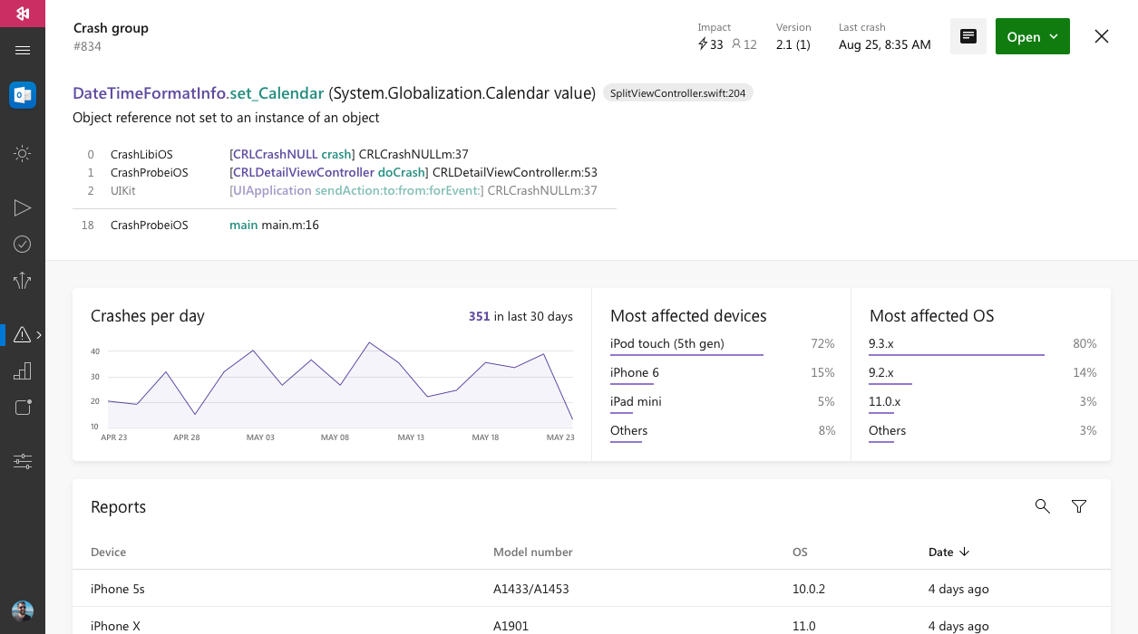
Solution Approach – Continuous Integration
App lifetime manage with Visual Studio App Center
Each crash of the app can be captured and statistically displayed in the App Center

Slide 12
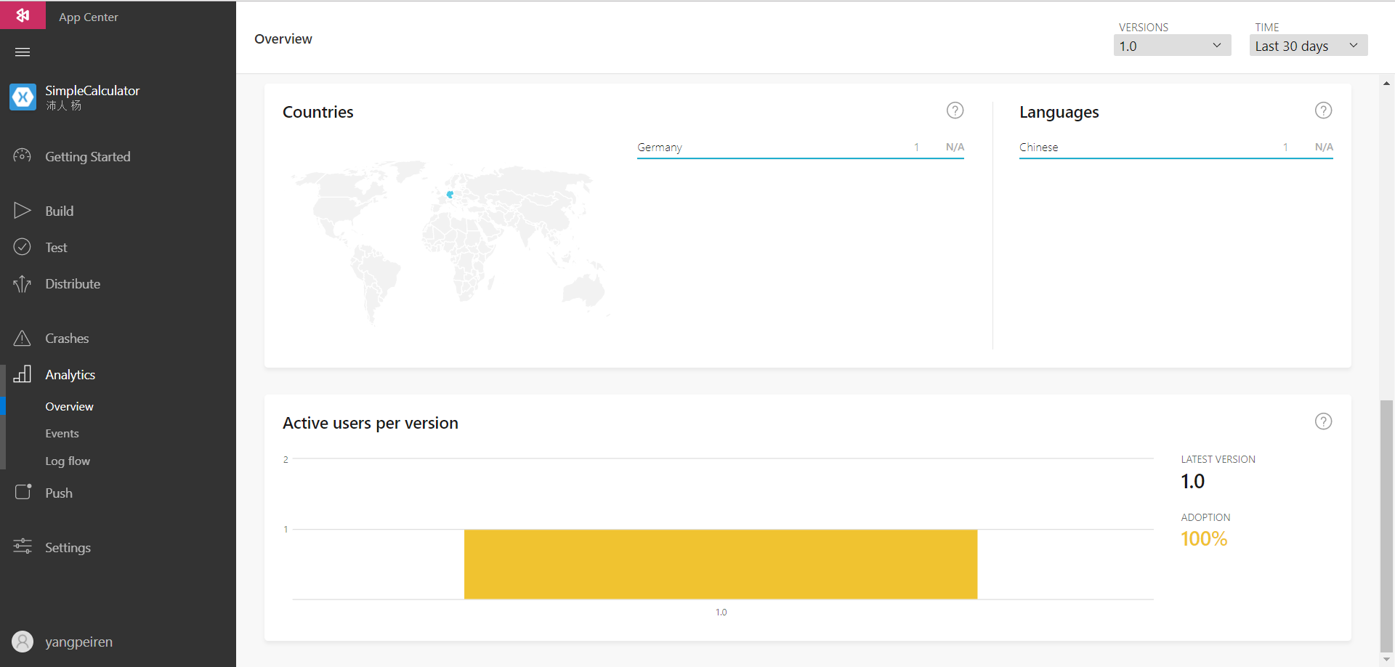
Solution Approach – Continuous Integration
App lifetime manage with Visual Studio App Center
Users who downloaded the published app are tracked by App Center, which is an important feature for the future improvement

Slide 13
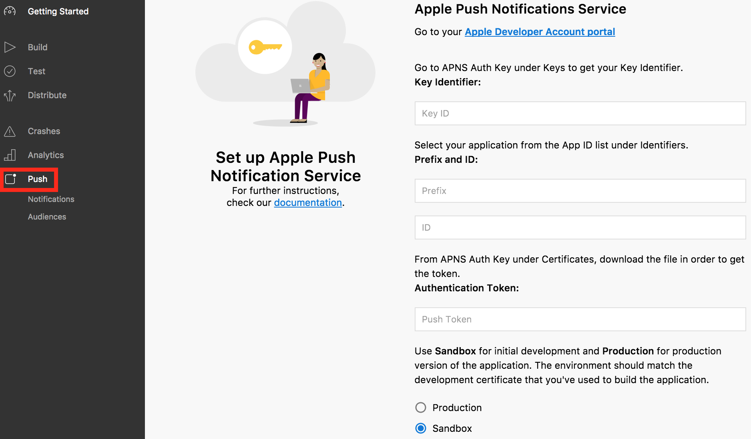
Solution Approach – Continuous Integration
App lifetime manage with Visual Studio App Center
Notifications can be pushed down to target groups in terms of their devices, their location, their app versions and other features

Slide 14
Conclusion
Visual Studio App Center is a powerful tool that particularly suitable for cross-platform app development
It offers project build in different platforms
It supports app tests with an enormous device farm
It offers interfaces for the management of app lifetime
The total price for using App Center as build and test platform is basically $139 per month, which includes:
$40 per month for unlimited build time (free for 400 hours)
$99 per month for unlimited tests

Slide 15
Conclusion
Disadvantage of using Visual Studio App Center
The job customization is not quite flexible, only three scripts can be configured and they must be executed consecutively
App Center is a new product of Microsoft, until now not all claimed features are available, some features are still on the way. And this have made a lot of difficulties in developing the solution.
Alternative solution
In most cases, Jenkins can be selected as substitution for each building or testing, or all functions, however, for testing a lot of physical devices with different OS version or different excessive emulators are needed.

Slide 16
Conclusion
Tools and Techniques used in the solution
Git and GitHub, Git Shell
C#, Xamarin, Visual Studio, Xamarin.UITest framework
Visual Studio App Center, App Center Command Line Interface with Node.js, Linux Shell for build scripts
Java JDK to generate keystore file for Android app
Markdown as document language

Slide 17
Q & A

Slide 18
Thanks for your attention!

